Slide 1
The Future of Catalog Marketing And The Great Eight: 2025
Kevin Hillstrom
President, MineThatData

Slide 2
What Happens When You Tell Catalog Marketing Professionals What The Future Might Look Like?

Slide 3
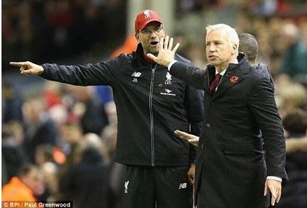

Slide 4
“If left unquestioned, membership co-ops might come to dominate the long stable, long profitable DM list world, and we might all be mailing long-term less-profitable names that somebody somewhere (without our input or consideration) justifies by saying, ‘Mail these.’”
Don Libey, DMNews, August 14, 2006

Slide 5
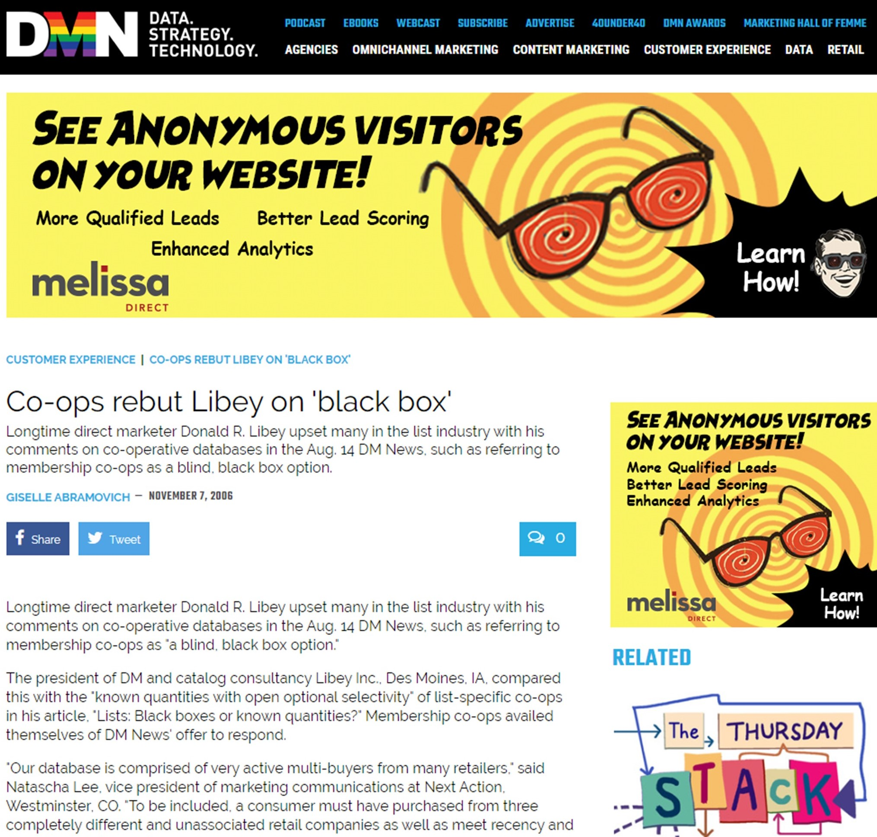
Folks Didn’t Agree With Mr. Libey When He Shared His Vision of the Future
Narrator: Mr. Libey, it turns out, was right.

Slide 6
Themes Coming to a
Catalog Marketer Near You

Slide 7
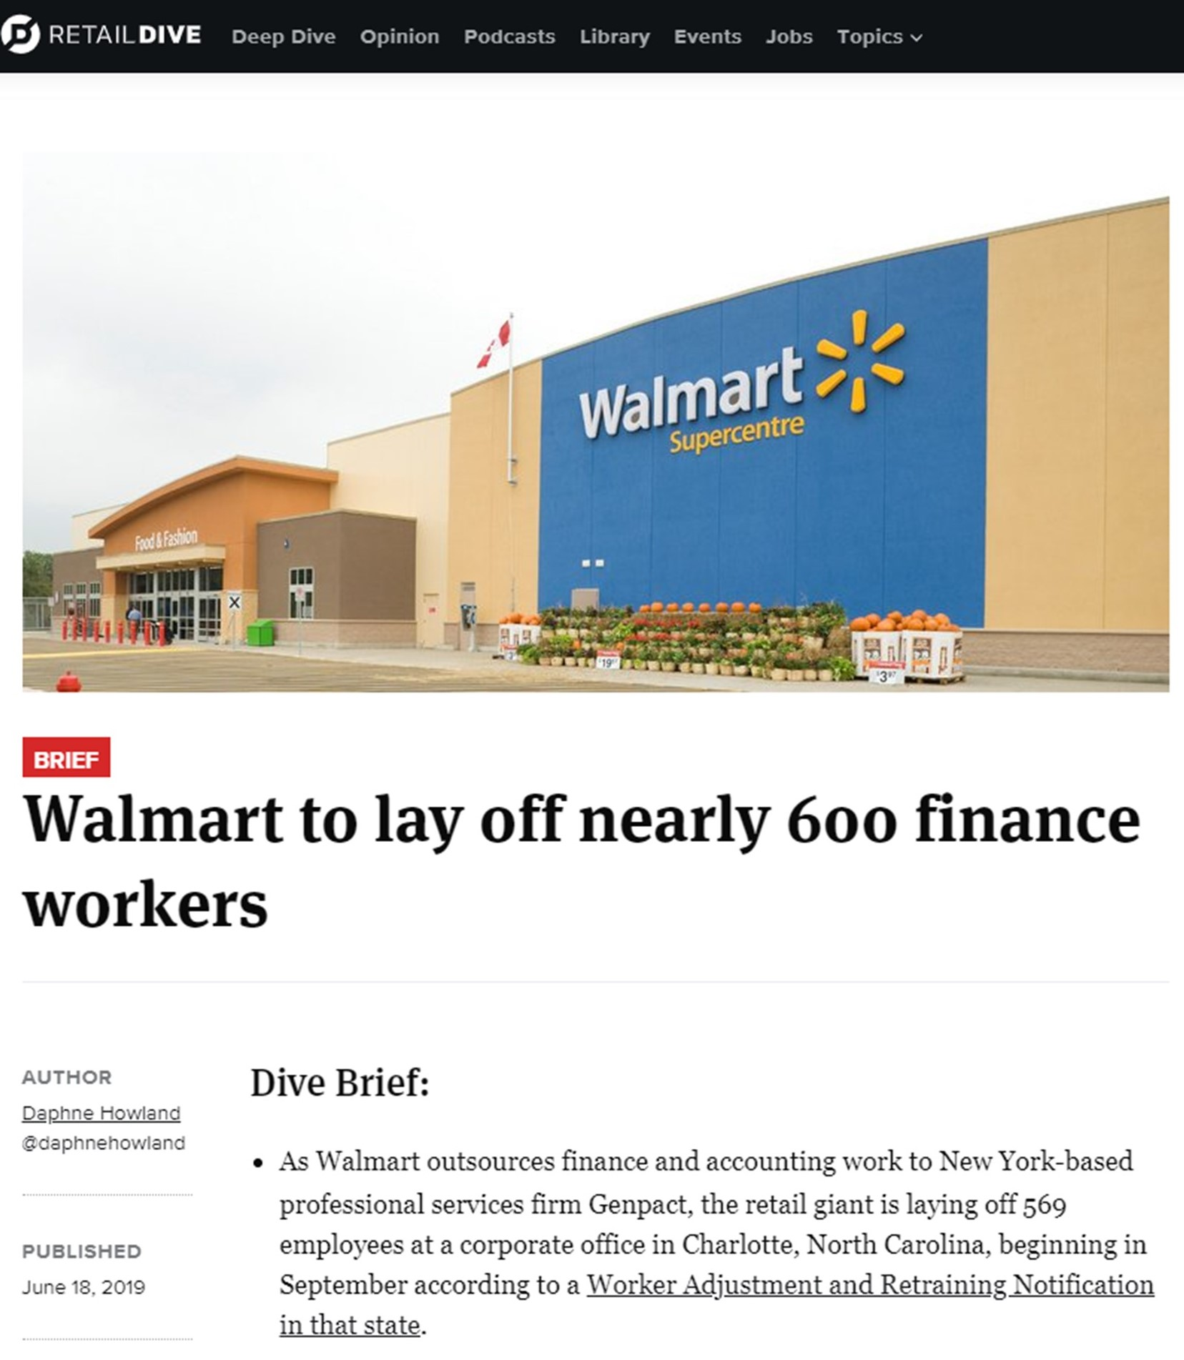

Slide 8
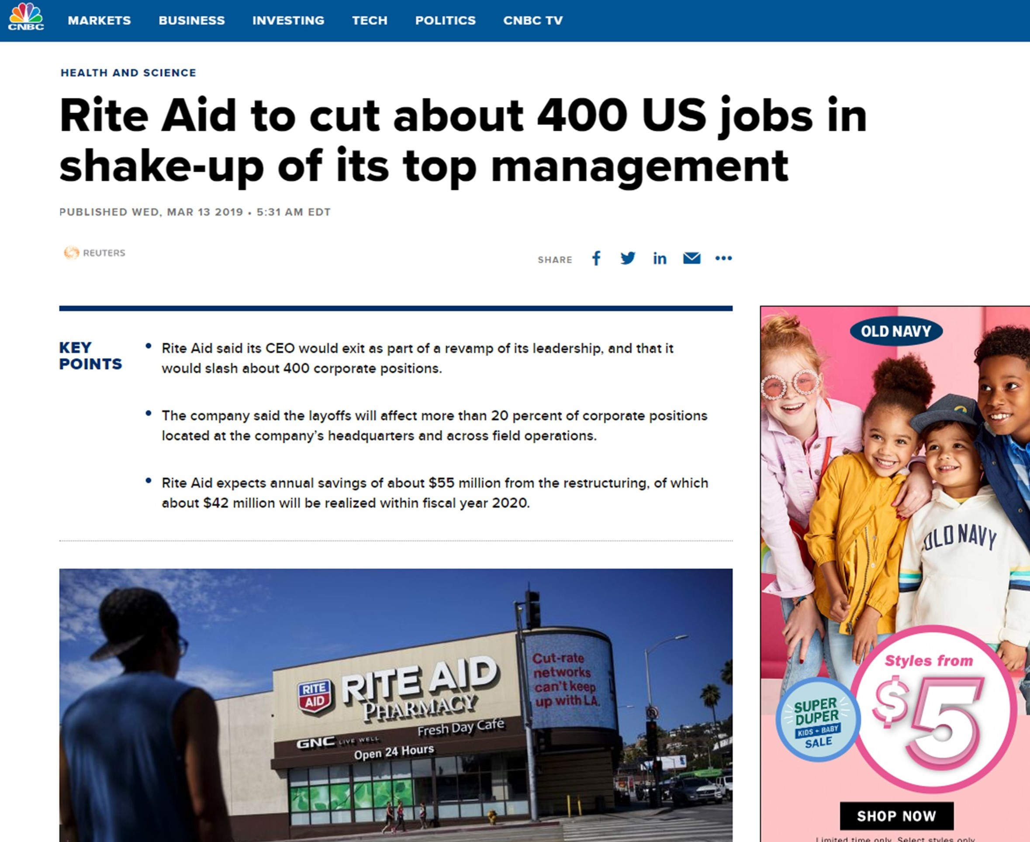

Slide 9
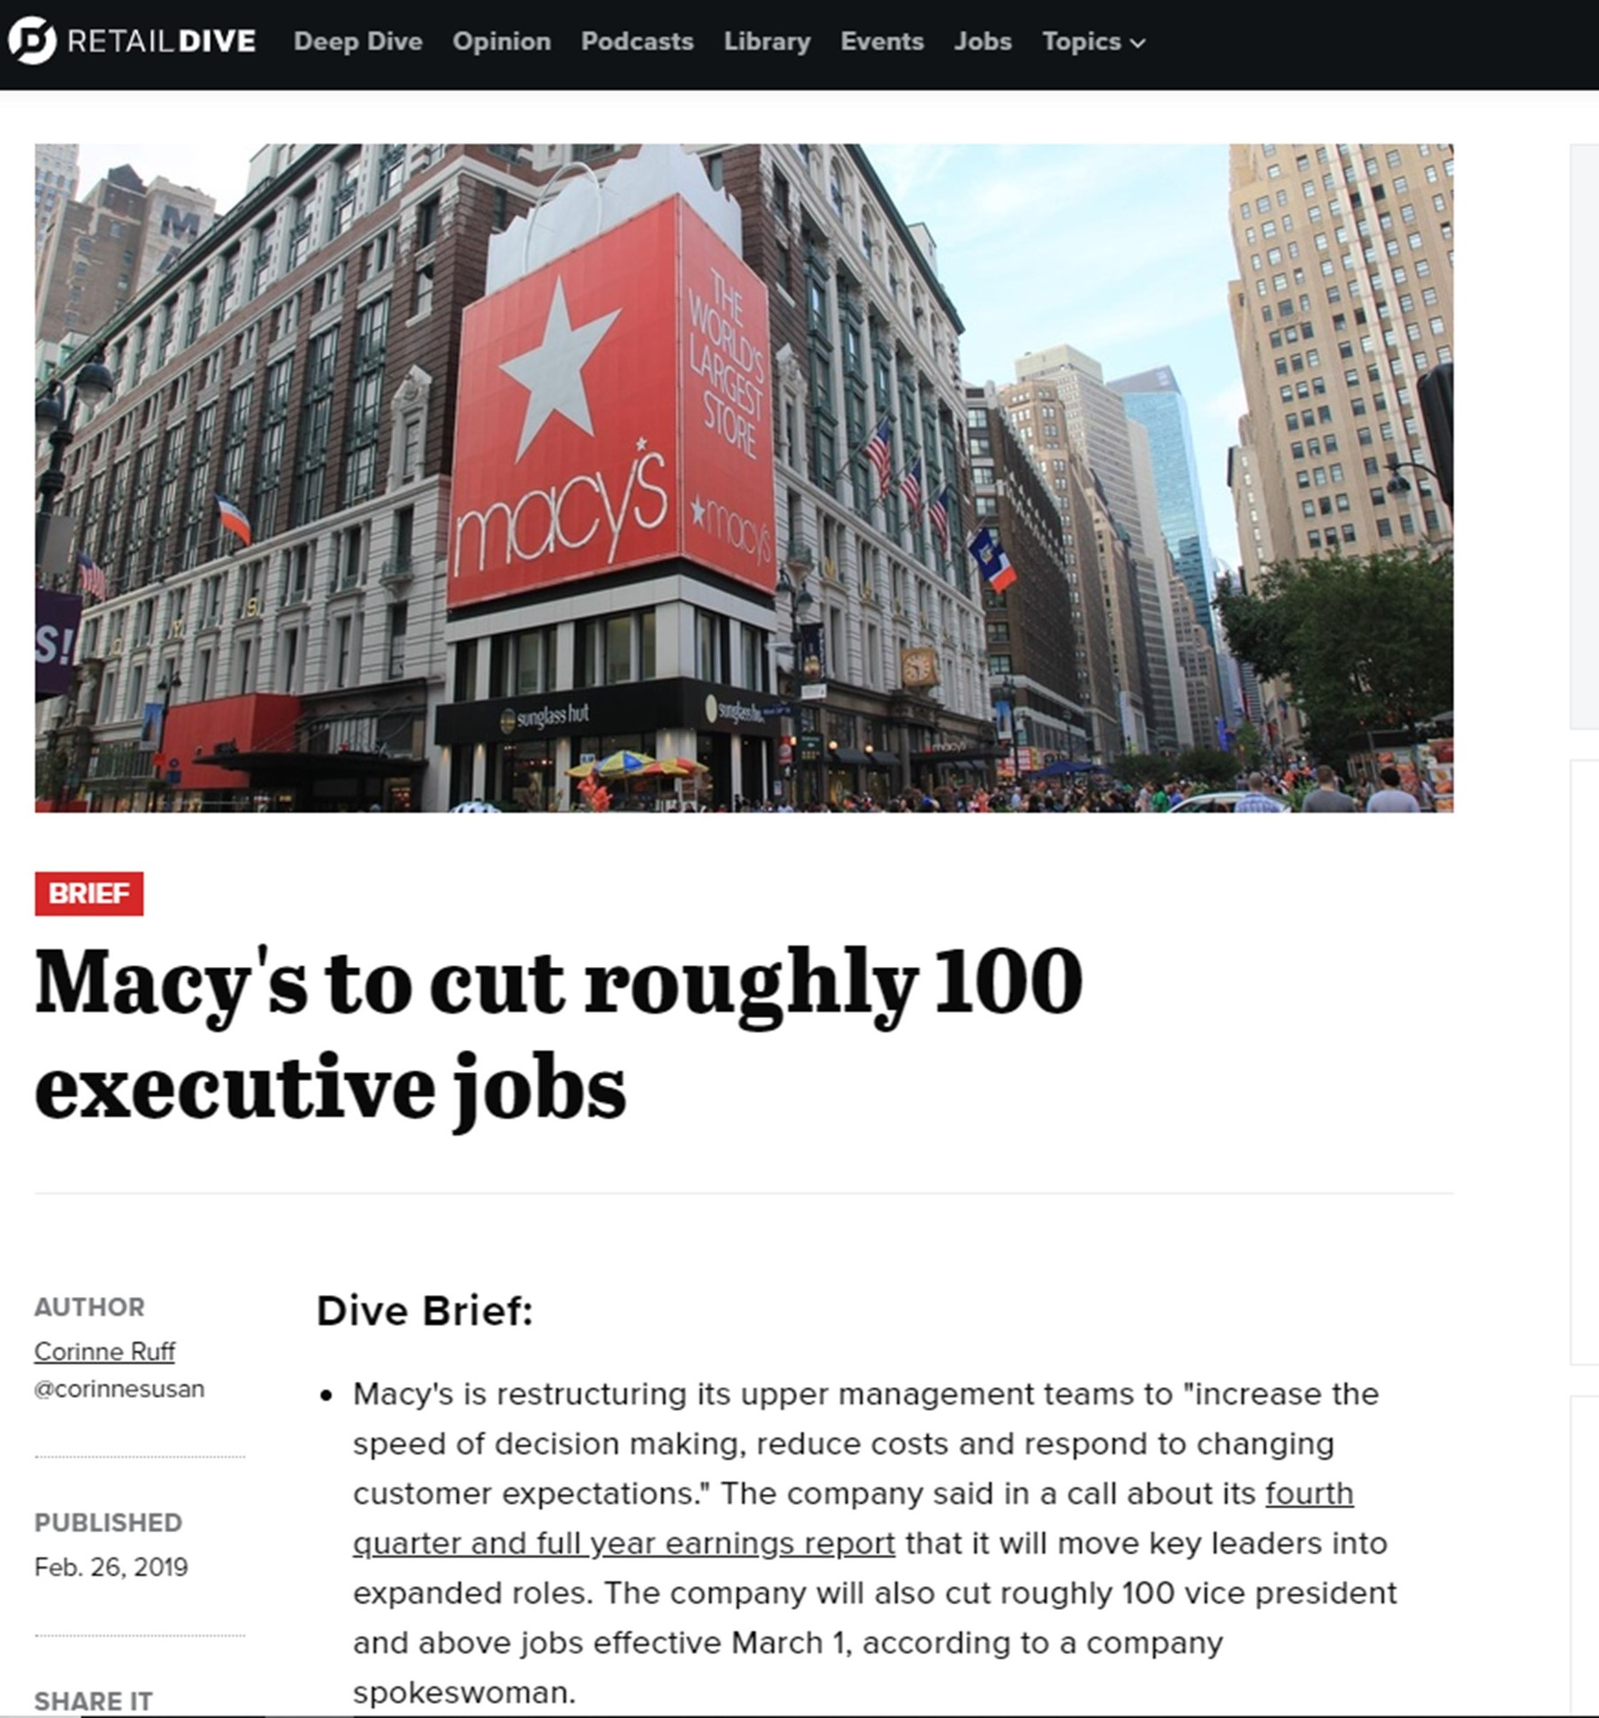

Slide 10
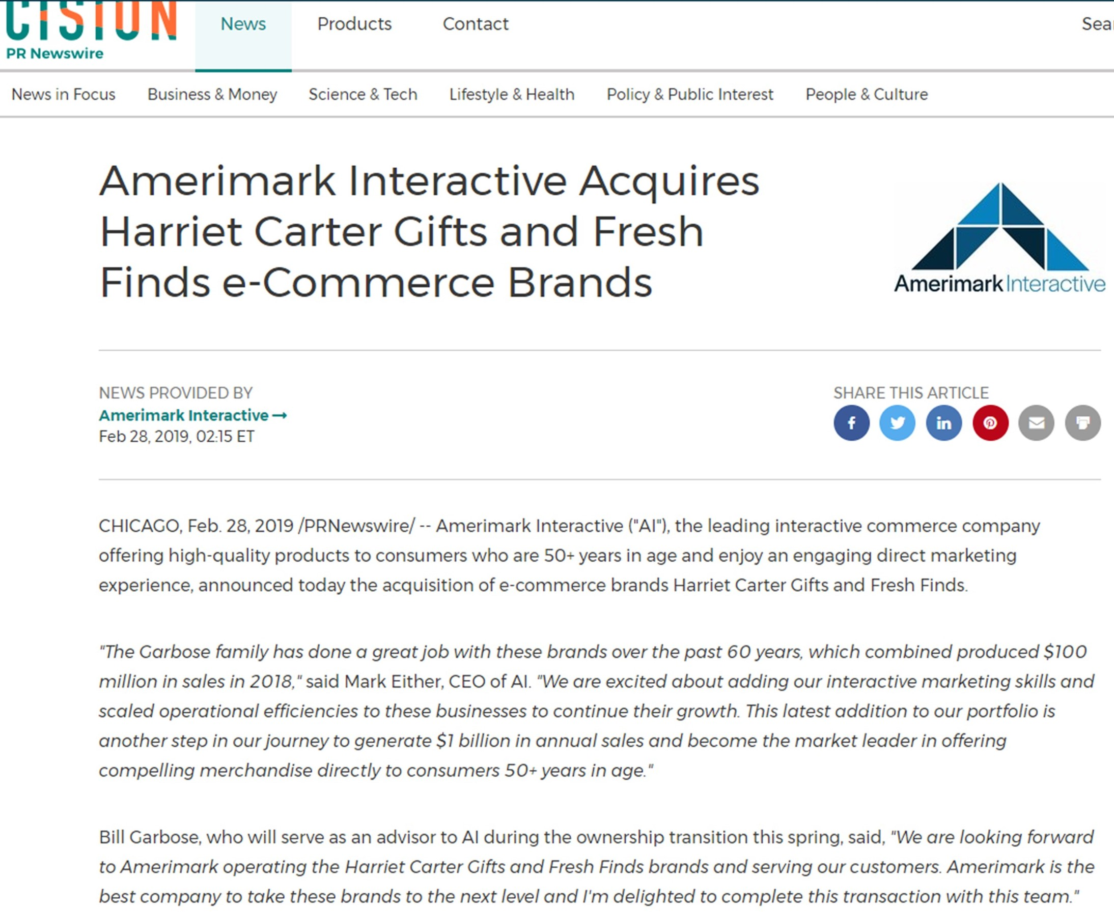

Slide 11
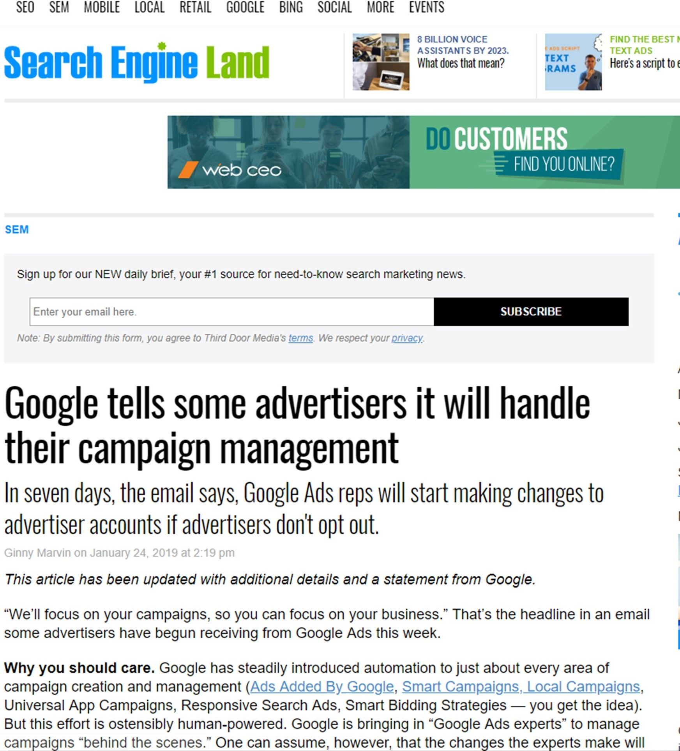

Slide 12
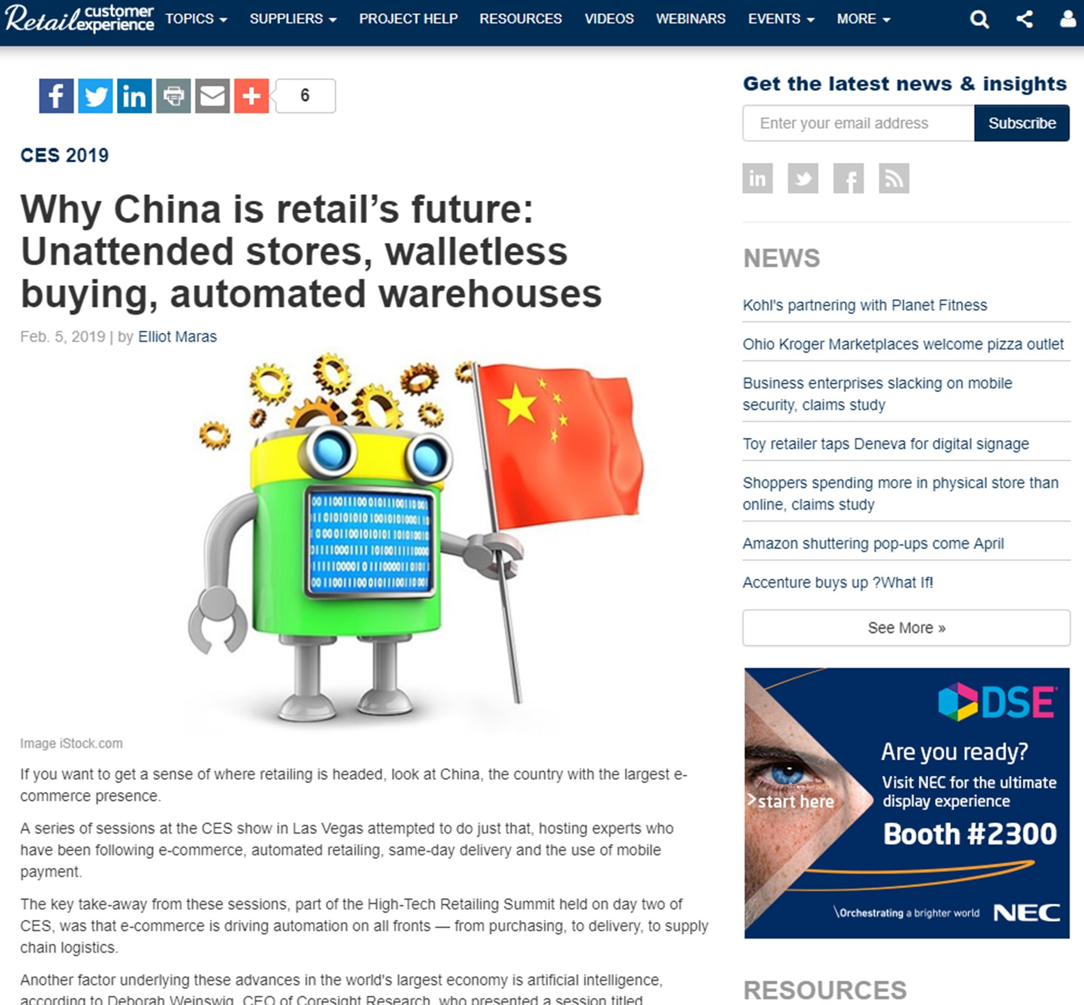

Slide 13
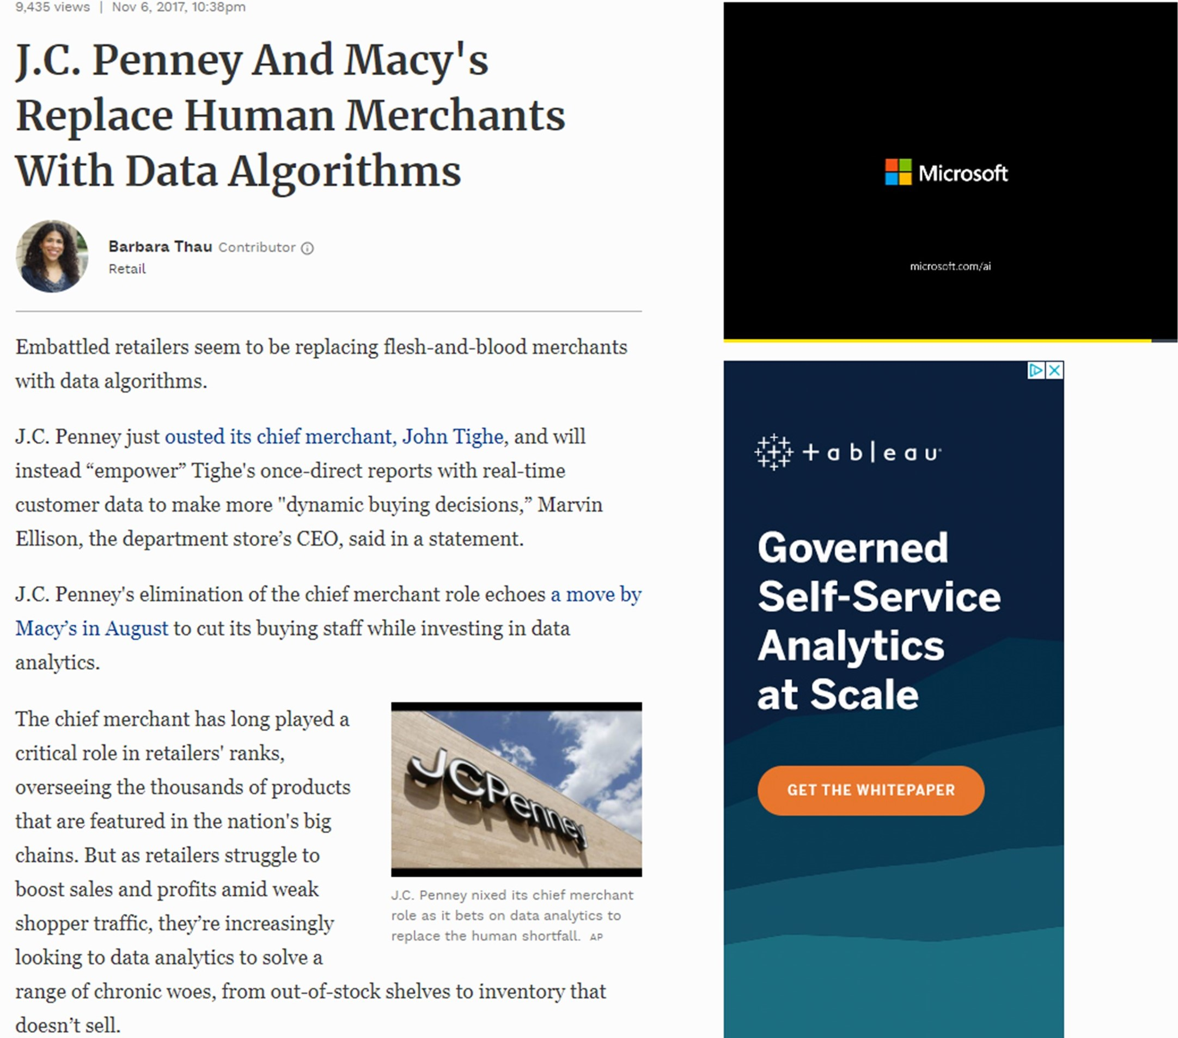

Slide 14
“The future of retail is one employee, the CEO, sitting in front of a touch-screen monitor and voice-activated speaker … setting algorithms and vendors into action based on dashboard results of real-time customer behavior.”
Kevin Hillstrom, March 13, 2019

Slide 15
Where Does That Leave The Future Of Catalog Marketing??

Slide 16
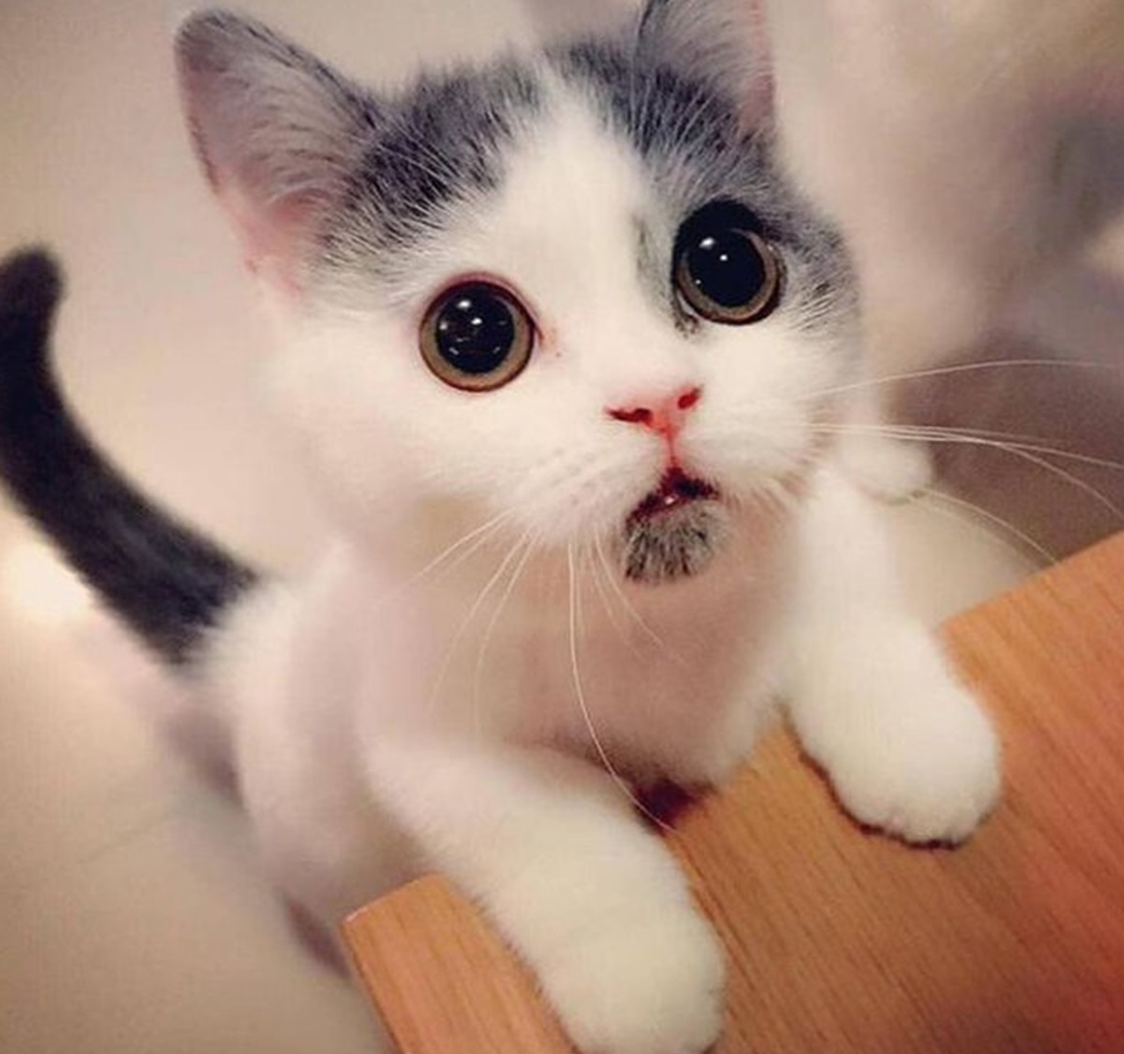

Slide 17
Three Paths
Path #1 = Catalog Holding Company (i.e. Potpourri Group)
Path #2 = Standalone Catalog Brand mailing 40x a year to a small number of best customers and 0x – 3x a year to everybody else while finding a new source of customers to replace catalog co-ops.
Path #3 = E-Commerce and/or Retail brand using catalogs 1x to 4x a year as an awareness tool.

Slide 18
Three Paths
Path #1 = Catalog Holding Company (i.e. Potpourri Group)
Will purchase brands that add unique and/or complimentary names to the shared database. Will shed brands that fail to deliver unique names or convert shared names to sister brands. A financial affiliation with minimal human expenses, and little merchandise creativity. Destined for short-term success and long-term trouble.

Slide 19
Three Paths
Path #2 = Standalone Catalog Brand
Will evolve. Will eliminate dependence upon catalog co-ops for new names. Will evolve from “campaign-centric” monthly-ish catalogs to 40ish catalogs dynamically created for the best 10% of the file and 0-3 small page count catalogs for everybody else. Simulations demonstrate this is the future. You run simulations, right? If you do, you know this is coming.

Slide 20
Path #2
500ish Page Catalogs, 2x per Year.
96-180 Page Catalogs, 9x – 18x per Year.
64-80 Page Catalogs, 12x – 24x per Year.
Catalogs will get smaller and more frequent.

Slide 21
What Is The Biggest Trend
Impacting Path #2?
Catalog Customer Bifurcation

Slide 22
What The Heck Is Bifurcation?

Slide 23
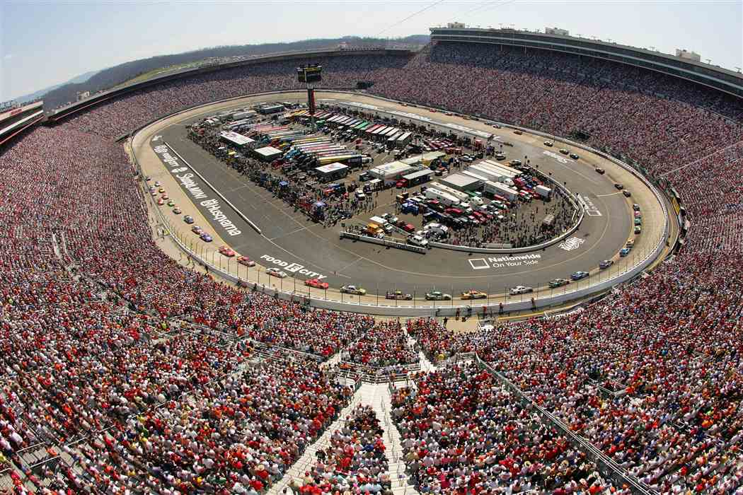

Slide 24
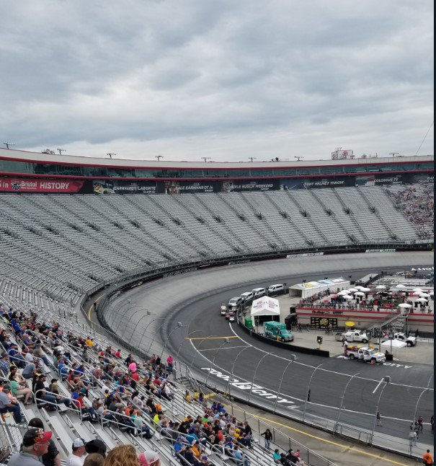

Slide 25
What The Heck Is Bifurcation?
“Bifurcation” is the splitting of the customer file within a catalog brand into two segments.
Segment #1 = Catalog Shoppers.
Segment #2 = Brand Shoppers.

Slide 26
Year 2000 = Catalog Shoppers.
Year 2006 = Catalog Shoppers buying Online. The end of the traditional list industry.
Year 2012 = Judy / Jennifer / Jasmine. Bifurcation begins.
Today = Bifurcation is in full force as only Judy wants to buy from catalogs.

Slide 27
Bifurcation
Measure three key elements of your business to determine if Bifurcation is taking over your business (hint – it is).

Slide 28
Bifurcation
Element #1 = Your Organic Percentage.
Element #2 = Frequency & Diminishing Returns.
Element #3 = Page Counts & Diminishing Returns.

Slide 29
Bifurcation
All three elements (Organic Percentage, Catalog Frequency, Catalog Page Counts) are easily measured via tests.
Simply execute the tests, gain the knowledge, then enter the data into your simulation environment.

Slide 30
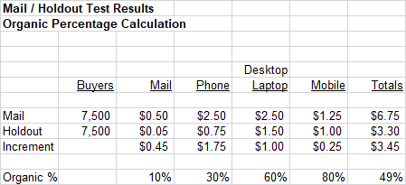
Organic Percentage Calculation

Slide 31
Catalog Frequency Testing

Slide 32
Page Count / Demand per Book

Slide 33
Let’s Compare Scenarios
We’ll assume the following:
Customer is forecast to spend $80 next year. Customer is forecast to receive 14 catalogs next year. Average page count is 80 pages.
Ready?

Slide 34
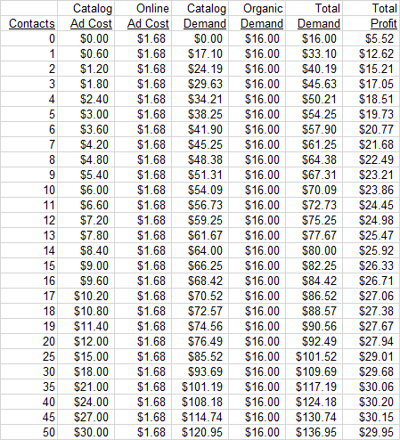
Low Organic Percentage – Catalog Buyer
$80 next year, 14 catalogs, 80 pages each.
Profit Factor = 45%. Average Catalog Cost = $0.60. Organic Percentage = 20%.
Optimal Strategy: Mail 40 Catalogs Per Year. This is classic BIFURCATION … mail MANY MORE catalogs to best catalog buyers.

Slide 35
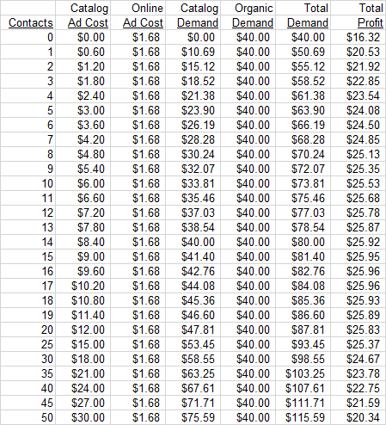
Mid Organic Percentage – Catalog Buyer
$80 next year, 14 catalogs, 80 pages each.
Profit Factor = 45%. Average Catalog Cost = $0.60. Organic Percentage = 50%.
Optimal Strategy: Same outcome mailing 8 catalogs per year as mailing 25 catalogs per year. This is classic catalog marketing from 2007 – 2017.

Slide 36
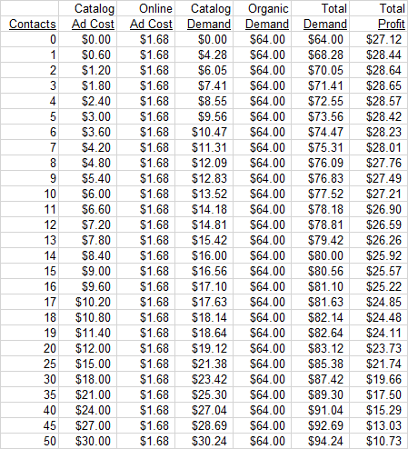
High Organic Percentage – Catalog Buyer
$80 next year, 14 catalogs, 80 pages each.
Profit Factor = 45%. Average Catalog Cost = $0.60. Organic Percentage = 80%.
Optimal Strategy: Three (3) catalogs. That’s it. Between 1 catalog and 7 catalogs are possible … but optimal is three (3).

Slide 37
Each Customer Is Worth $80 Next Year
Low Organic Percentage (True Catalog Buyer) = 40 Catalogs Per Year.
Mid Organic Percentage (Buyer From 2007 – 2017) = 17 Catalogs Per Year.
High Organic Percentage (Modern Buyer) = 3 Catalogs Per Year. That’s It!!!!

Slide 38
Bifurcation = The Future
of Catalog Marketing
In the past decade, customers were low-organic-percentage (pure catalog buyers) and mid-organic-percentage (multichannel buyers). This meant a diet of a catalog a month was appropriate. Those days are ending.

Slide 39
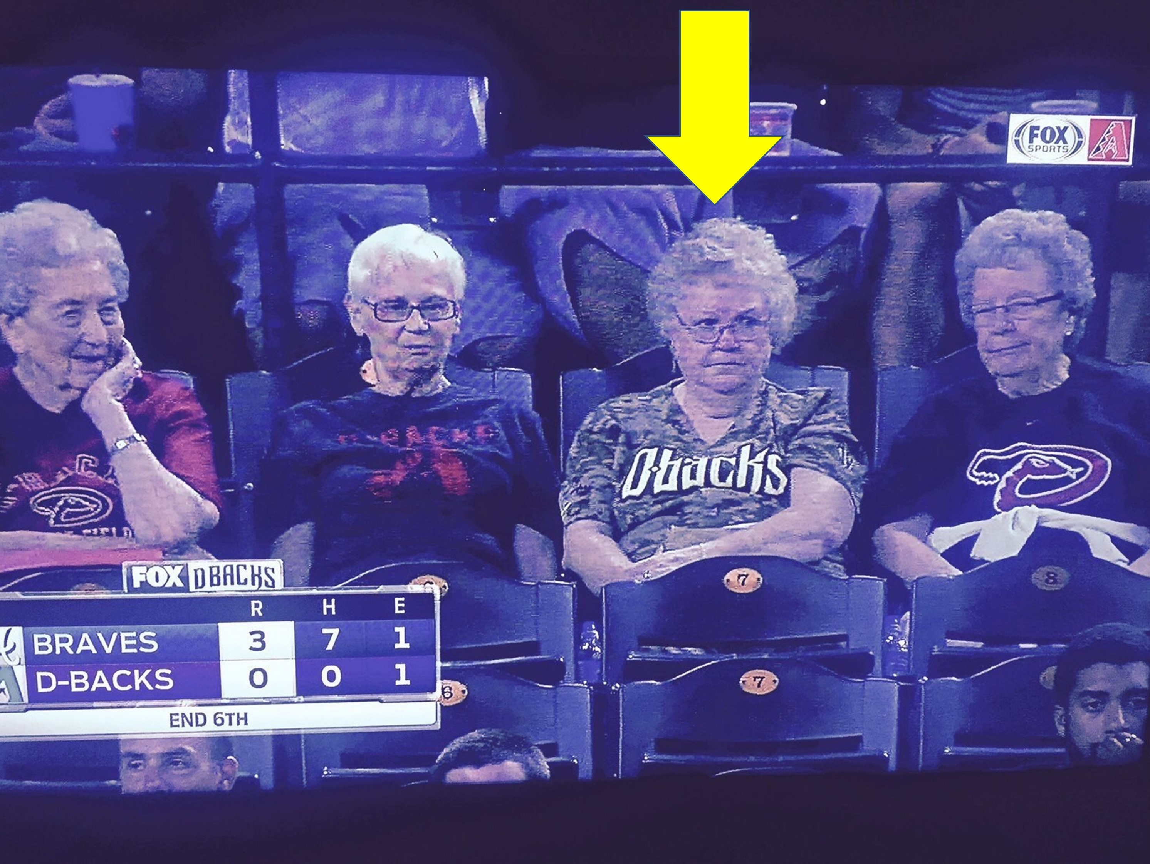
Bifurcation = Many Mailings To Best Catalog Customers

Slide 40
Bifurcation = The Future
of Catalog Marketing
In my project work, it is clear that customers who buy exclusively online do not need many (any) catalogs anymore, especially those age 50 and under. Conversely, older catalog-centric customers are likely being under-contacted, if you can believe that!! Yes!

Slide 41
Bifurcation = What Does This Mean?
In 2019, your catalog strategy likely has a fixed number of contacts, and you select who to mail catalogs to from this fixed number of contacts.
This strategy will not be effective come 2025. At all.

Slide 42
Bifurcation = What Does This Mean?
In 2025, you will employ a “variable contact strategy”.
What is a “variable contact strategy?”
It’s what it says it is … it’s “variable” based on customer quality and merchandise preference.

Slide 43
Bifurcation = What Does This Mean?
Best Catalog Customers? They’ll receive weekly contacts, and those contacts will be dynamically generated (i.e. 16-32 pages with merchandise that aligns with prior purchasing habits). There may be four “quarterly” campaigns at high page counts, but otherwise contacts will be dynamically generated.

Slide 44
Bifurcation = What Does This Mean?
High Organic Percentage? These customers will receive 0-2 large page count catalogs per year or they will receive 1-6 small page count catalogs per year. These customers don’t buy via catalogs, therefore, marketing investment must happen elsewhere.

Slide 45
Bifurcation = What Does This Mean?
Hotline Program? First-time buyers will enter a three-month hotline program where contacts will be dynamically generated. This will be a critical part of a “Welcome Program” (more on that later).

Slide 46
Bifurcation = What Does This Mean?
Page Counts? Most page counts will decrease. Why? Because most pages are not interesting to a customer, and because CONTACTS > PAGES. It is better to send four 32 page contacts than to send one 96 page contact. For high organic percentage customers, this becomes a viable strategy.

Slide 47
Bifurcation = What Does This Mean?
Merchandise Personalization? A UK vendor presented at a conference a few weeks ago. Sending 16 pages with a personalized merchandise assortment yielded a 5% increase in response and a 25% increase in AOV over a catalog with 16 pages of normal merchandise.

Slide 48
Simulation Environment
Make sure your favorite catalog agency (Belardi/Wong, Cohere One etc.) operates a simulation environment that enables you to determine the variable strategy that will be most effective.
Ask them today to build the environment for you. Seriously. Do it today.

Slide 49
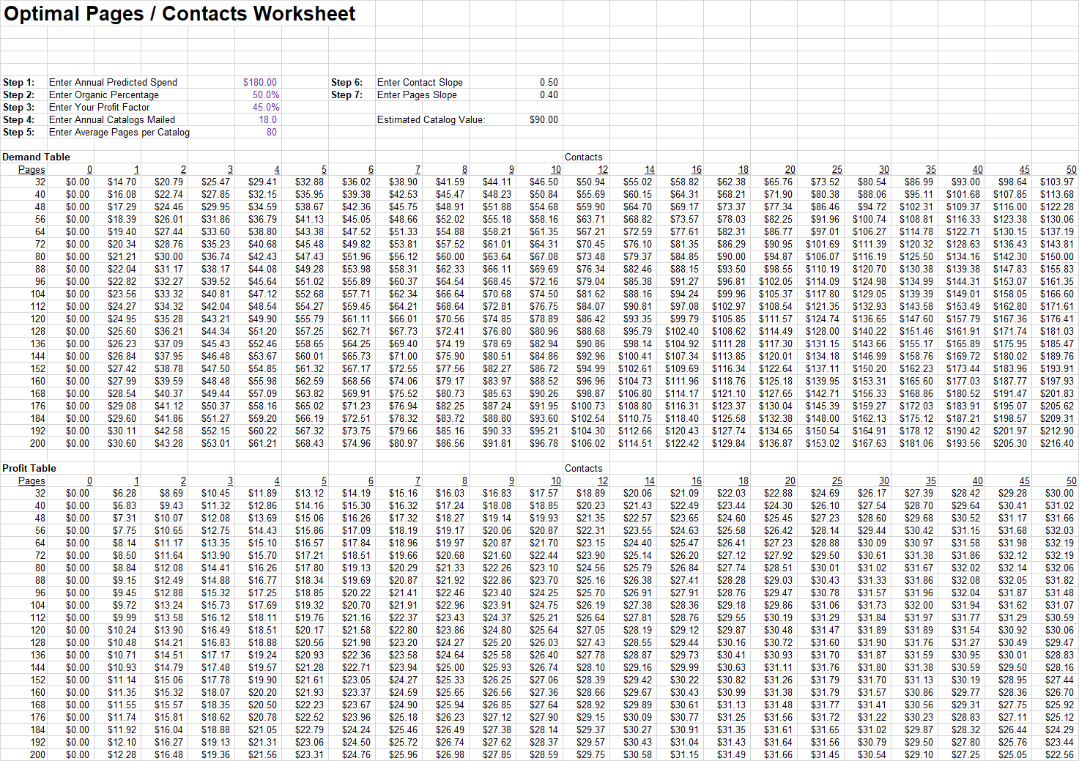

Slide 50
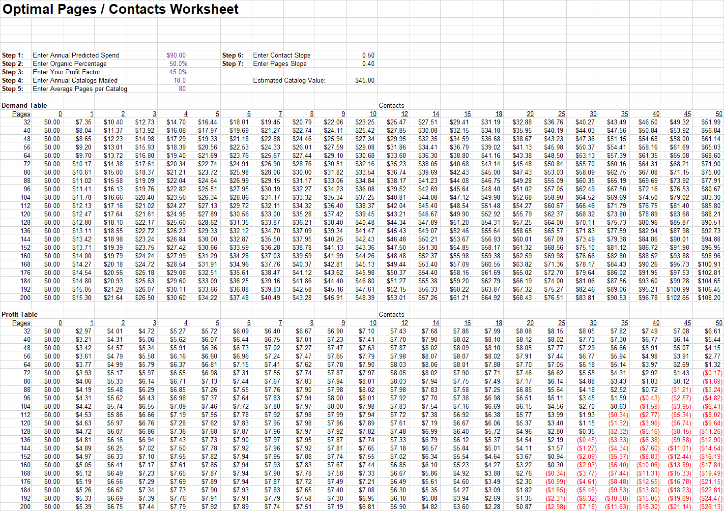

Slide 51
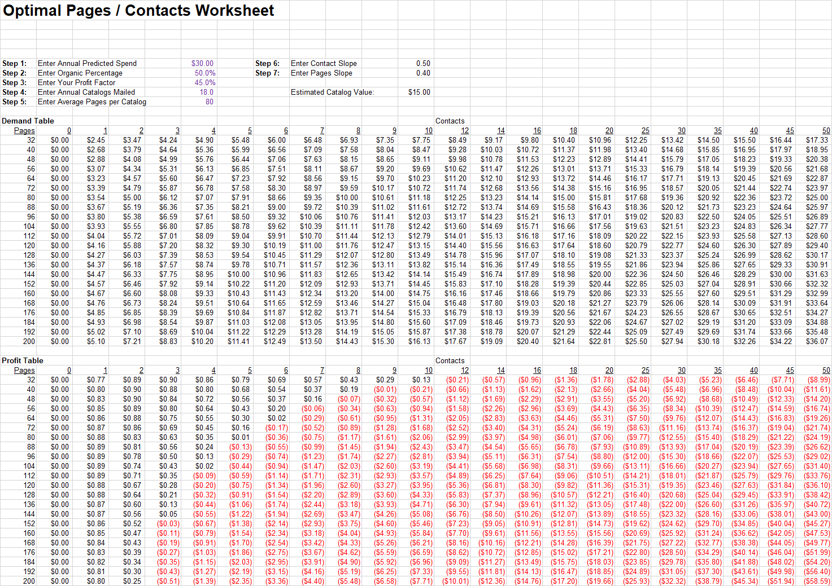

Slide 52
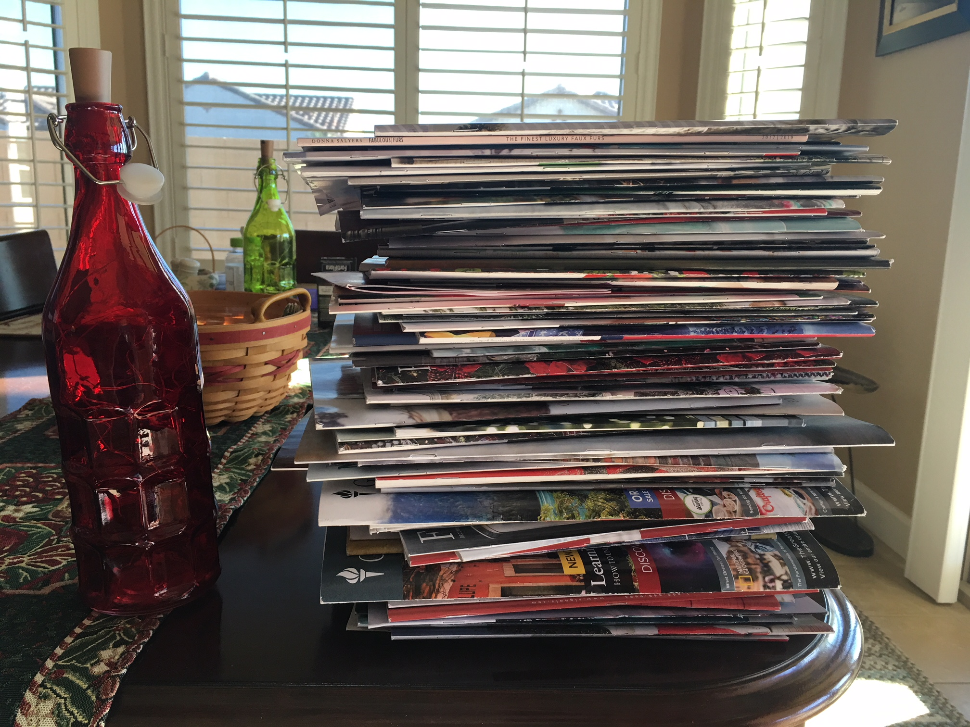

Slide 53
Three Paths
Path #3 = Awareness Tool
Retailers and/or E-Commerce brands will use catalogs as awareness tools. Our industry will misinterpret this signal as a resurgence of print.
This is not a resurgence of print. This is how companies will try to find ways to generate awareness in an effort to avoid toll collectors like Amazon, Google, and Facebook.

Slide 54
Catalogs 2025
Expensive Catalog Pages will require best sellers in order to deliver a sufficient return on investment.
Catalog Marketing will become “Winners Marketing”. Social / Email / Home-Landing Pages (i.e. free marketing) will be the domain of new merchandise.

Slide 55
Catalogs 2025
Customer Acquisition via co-ops will still exist, but will be greatly de-emphasized (already happening) as ROI continues to decline. The cataloger will be required to find new names outside of co-ops / Google / Facebook, and this will greatly accelerate the evolution of the cataloger toward Bifurcation.

Slide 56
Catalogs 2025
Traditional Customer Acquisition can still be achieved by “Catalog Holding Companies” (think Potpourri). These companies will kill dying brands and acquire complimentary brands with somewhat unique customers in an effort to fuel sister brands with new catalog customers, staving off Bifurcation.

Slide 57
Catalogs 2025
Non-Traditional catalogers will leverage catalogs as branding/advertising tools. I lived through this experience at Nordstrom … traditional productivity decreased by 70% or more. This will not be “proof” that paper is valuable … this will be proof that it is really hard to obtain the attention of a customer.

Slide 58
Catalogs 2025
Many traditional catalog brands will go bankrupt (or be bought by catalog holding companies for pennies on the dollar) because the traditional catalog brand failed to manage Bifurcation properly. Change is coming, it is required, and those slow to change will be absorbed or will be disbanded.

Slide 59
Catalogs 2025
FUN!!! Catalog marketing will be a lot more fun in 2025 than it is today. Seriously!
It will be fun and rewarding to solve the Bifurcation problem. It will require skills you didn’t know you possessed! But you are ready for this, aren’t you??!!

Slide 60
Catalogs 2025
Bifurcation is coming … weekly contacts dynamically generated for best customers, 1-6 small page count contacts for everybody else. This is a completely different way to run a catalog business, and it will be so much fun to figure out how to manage a business in this manner. You are ready for this!!!!

Slide 61
Catalogs 2025
How Will We Respond?

Slide 62


Slide 63
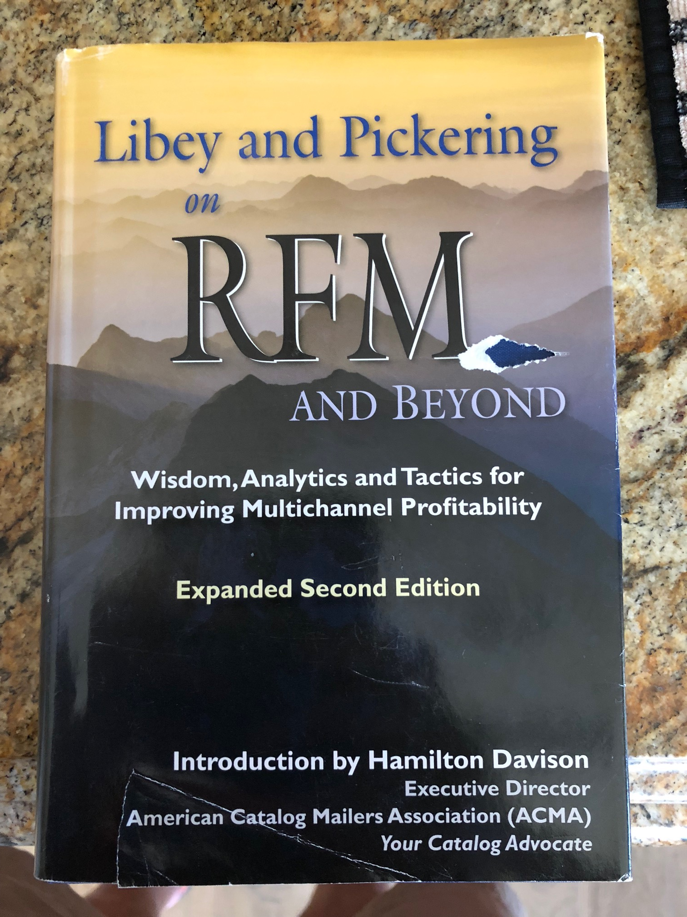

Slide 64
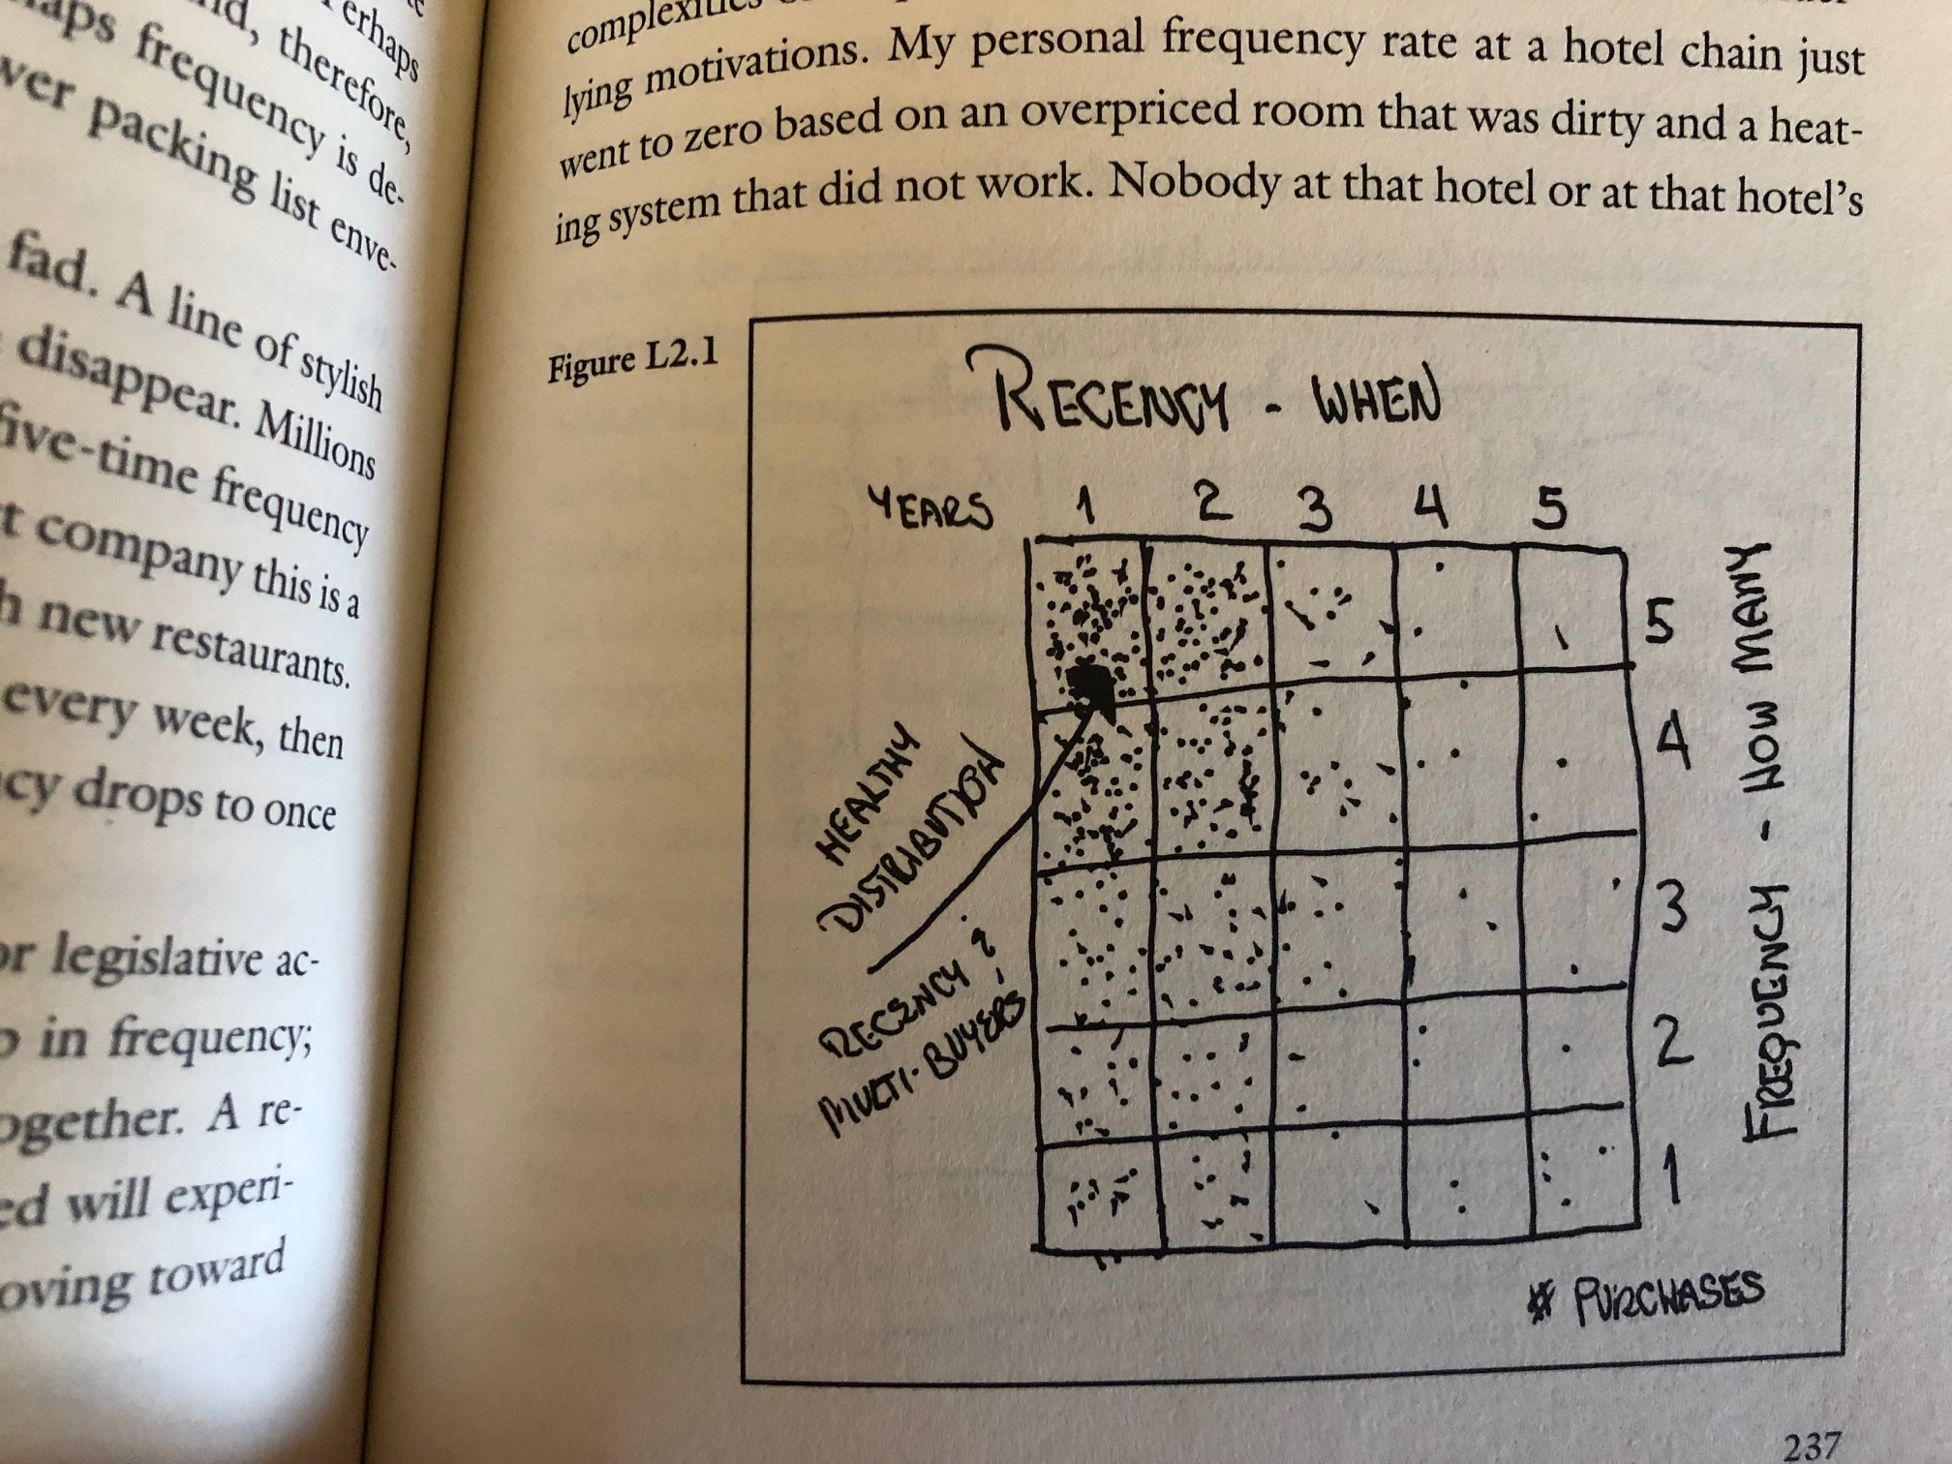

Slide 65
As A New VP/Marketing At A Catalog Brand, Have A Plan (A Marketing System Of Your Own) On Day One, And Constantly Reinforce Your Message To All Employees Every Single Day Of Your Tenure

Slide 66
The Great Eight
Audience
Awareness
Acquisition
Welcome Program
Anniversary Program
Optimization Program
New Merchandise
Winning Merchandise

Slide 67
How Does Each Path Leverage The Great Eight??
Path #1 = Catalog Holding Company.
Path #2 = Standalone Cataloger.
Path #3 = Retail and/or E-Commerce Brand Leveraging Catalogs as Awareness Tools.
The Great Eight
Audience
Awareness
Acquisition
Welcome Program
Anniversary Program
Optimization Program
New Merchandise
Winning Merchandise

Slide 68
The future should be SO MUCH FUN. Seriously!
But we have to be proactive, responding to changes today so that our businesses are ready to handle business in 2025.
Are you ready?

